Slide 1

CAP539 ALGORITHM DESIGN AND ANALYSIS - Laboratory
Binary Search – Divide and Conquer

Slide 2
Binary Search
Problem: Given a sorted array arr[] of n elements, Binary search is used to search a given element x in arr[] and return the index of x in the array.
Examples:
Input: arr[] = {10, 20, 30, 50, 60, 80, 110, 130, 140, 170}, x = 110
Output: 6
Explanation: Element x is present at index 6.

Slide 3
Binary Search Algorithm Steps
The basic steps to perform Binary Search are:
Begin with the mid element of the whole array as a search key.
If the value of the search key is equal to the item then return an index of the search key.
Or if the value of the search key is less than the item in the middle of the interval, narrow the interval to the lower half.
Otherwise, narrow it to the upper half.
Repeatedly check from the second point until the value is found or the interval is empty.

Slide 4
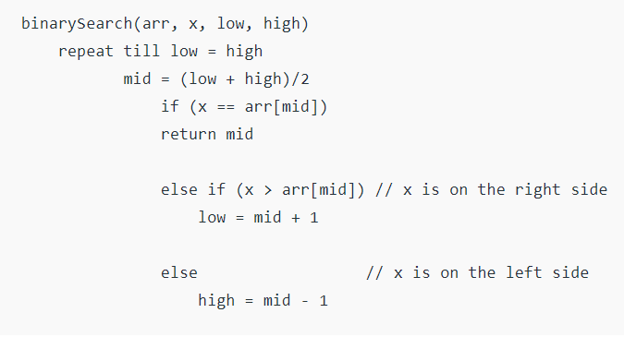
Binary Search (Iterative)
Binary Search Algorithm (Iterative Algorithm)

Slide 5
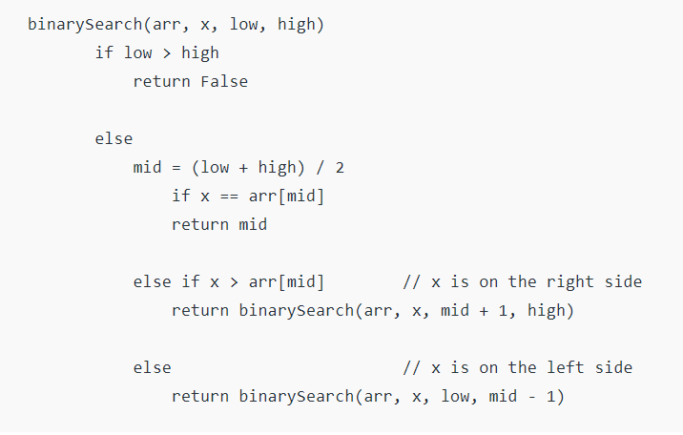
Binary Search (Recursive)
Binary Search Algorithm (Recursive Algorithm)

Slide 6
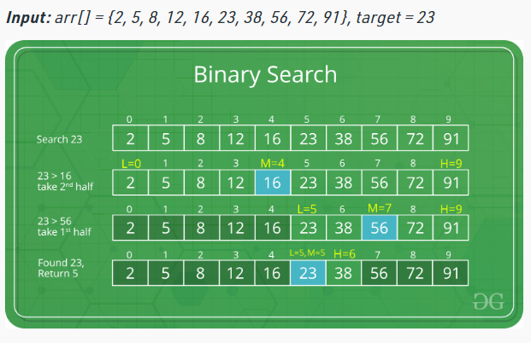
Analysis of Binary Search
Example :

Slide 7
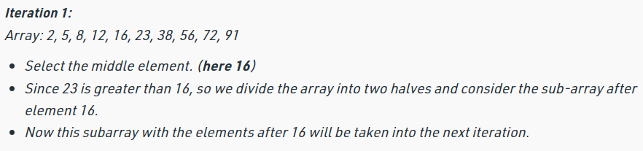
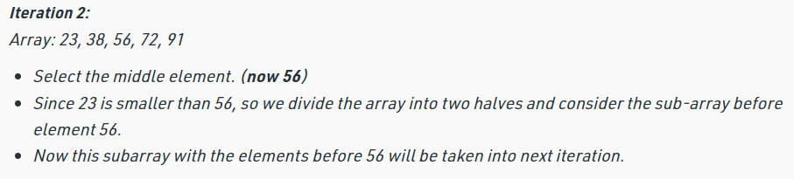
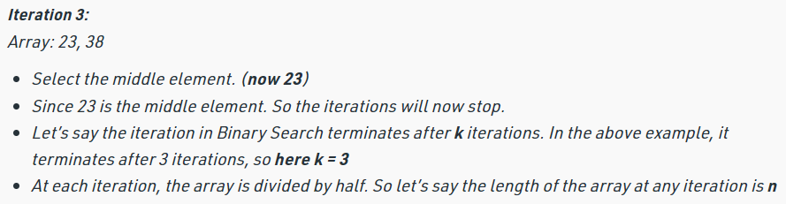
Analysis of Binary Search
Steps in previous example :

Slide 8
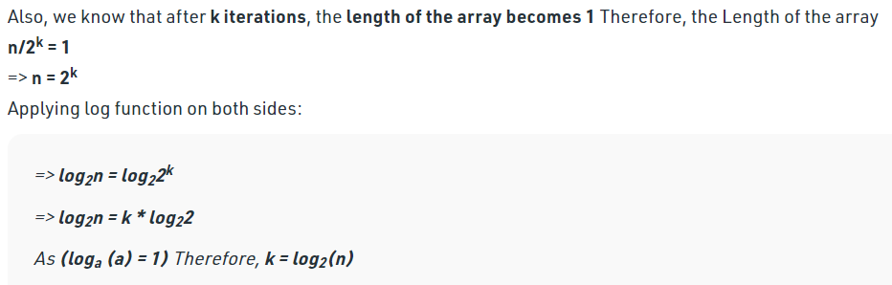
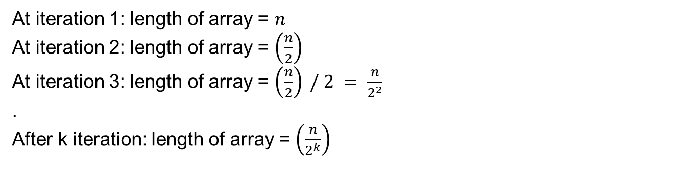
Analysis of Binary Search
Analysis of Array input size:
At iteration 1: length of array = $n$
At iteration 2: length of array = $\left(\frac{n}{2}\right)$
At iteration 3: length of array = $\left(\frac{n}{2}\right) / 2 = \frac{n}{2^{2}}$
.
After k iteration: length of array = $\left(\frac{n}{2^{k}}\right)$

Slide 9

Thank You

